Slide 1
Making Business the Open Source way
Exploring the business opportunities in open source projects, legal implications, frameworks and roles that can improve sustainability in an+ Open-Source geared businesses
Andrew Miracle
October 13, 2018

Slide 2

$: whoami Software Developer, Entrepreneur, Writer learn more at www.andrewmiracle.com

Slide 3
QUICK QUESTION ? - Who has ever used an open source software ? - Who here has created, maintained or contributed to one ?
Free Open Source Software (FOSS)
Firefox Browser
Libre Office
Emacs
Sublime Text
Open Source Software (OSS)
Linux
React
PHP
Vscode

Slide 4
We are in an information economy, since the industrial revolution we have communication, computational capacity, experience and social influence in the power of humans.

Slide 5
Who dat one epp ?

Slide 7
- OPEN DATA - OPEN SOURCE TOOLS/RESOURCES - OPEN SOFTWARES AND PLATFORMS Open Source for Governance, Sustainability, HealthCare, Productivity

Slide 8
let’s move forward →

Slide 9
What can open-source do for you
Find a job
Launch a Business
Expand your skills
10XX | 20X | 30X | 50X

Slide 10
Find a Job, Get Hired

Slide 11
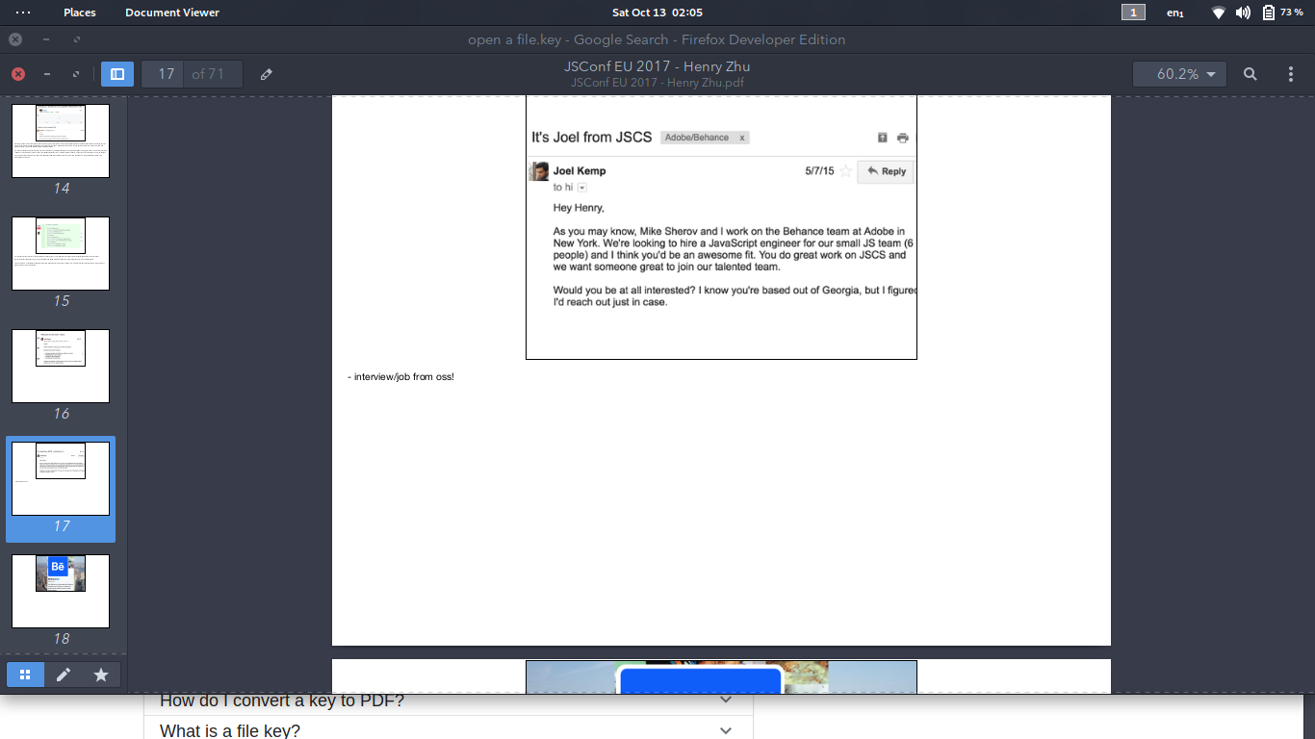

Henry Zhu, Babel Maintainer receives job offer from Behance

Slide 12
Launch a Business

Slide 13



Collaboration is the new Sheriff in town

Slide 14
we learn how Github and Gitlab built a value proposition using an open source platform `GIT` we will later explore this business as the open core platform used by segment, github, gitlab, gravit, gitkraken and lot more organizations

Slide 15

Using Open source as a model to test for demand in a particular niche
Test for Demand

Slide 16
How segment used analytics.js to test for product market fit for their analytics platform segment.com
segment.com

Slide 17
MongoDB an open-source database schema created MongoDB Enterprise, MongoDB Atlas and acquired mLab to provide a DBAAS solution for profitability from an open-source project MongoDB
Mongo DB

Slide 18




Linux built a kernel that has allowed itself to be extended into other products by different companies
Canonical
RedHat
Android
Apache Foundation
Canonical created Ubuntu, Ubuntu Server and Ubuntu Enterprise with their LTS Version
Redhat has transitioned from a Linux Enterprise to creating plethora of software that extends the linux stack Ansible, Openstack more
Android extended the Linux kernel to build a mobile operating system efficient and fast
Apache built a web server that runs on linux to compete with Microsofts IIS

Slide 19
USE OPENSOURCE TO CREATE A SUPPLY CHAIN

Slide 20
Fedena is an opensource school management software built with ruby on rails that transitioned into a pro and enterprise suite using the Addons model to add more features to their core platform Fedena OSS
Fedena vs Fedena Pro

Slide 21
https://github.com/odoo/odoo
Odoo extended their CRM offering using the OSS Model
ODOO CRM

Slide 22
React, Vue and Angular has created a supply chain for developers looking to build cross-platform, modular and interactive frontends using JavaScript frameworks, opening up a market for testing platforms, build tools, prototyping tools etc
Mocha, React Proto, Webpack, Apollo etc.
REACT JS VUE JS ANGULAR

Slide 23
React, Vue and Angular has created a supply chain for developers looking to build cross-platform, modular and interactive frontends using JavaScript frameworks, opening up a market for testing platforms, build tools, prototyping tools etc
Mocha, React Proto, Webpack, Apollo etc.
REACT JS VUE JS ANGULAR

Slide 24
Forge built a server platform for laravel apps, serverpilot built a platform for automatically setting up and managing php servers without the security bottlenecks
PHP / LARAVEL/ SYMPHONY/ CODEIGNITER

Slide 25
Wakatime is a productivity app that lets you track how much time you spent coding everyday.
VSCODE SUBLIME ATOM

Slide 26
USING OPENSOURCE TO CREATE / INCREASE BRAND IDENTITY / AWARENESS

Slide 27
StickerMule became popular for printing stickers swags for open source projects

Slide 28

DigitalOcean / Linode contributed to OSS by offering free cloud services to Open source projects

Slide 29
WIKIPEDIA became popular by offering an open encyclopedia compared to ENCARTA and the rest

Slide 30
The APACHE FOUNDATION immense contribution to opensource by sponsoring several open source initiatives and the popular APACHE LICENCE for popular open source projects

Slide 31
Microsoft created TypeScript and VSCODE to identify with the opensource community before subsequently acquiring Github

Slide 32
IN THE HIGHLIGHTS
CODE FOR AFRICA | openafrica.net
Provides an open data platform for Foreign organizations to mine about the African ecosystem, gender equality, employment ratio, earning analysis, and lots more

Slide 33
INNOVATING WITH OPENSOURCE

Slide 34
BLOCKCHAIN Blockchain provides a social framework for transparency and openness in today’s technology driven ecosystem. Open Source is going to be the standard in a decentralized economy, and all of the critical things used in the marketplace and common business practices. A new economy is emerging and new opportunities are opening.

Slide 35
MONEY VERSUS TIME launching a business using an open model

Slide 36
Apache Foundation
Linux
Mozilla Foundation
Android
This model ensures that the company is successful at the risk of not having a successful product
Foundation Based Model

Slide 37
MongoDB,
VueJS,
Node
Laravel
In this model, the core product and the company are the same thing
Singular Business Model

Slide 38
Segment (extends analytics.js)
Mlab (extends MongoDB)
Open core is a business model in which the core of a program is open source, with additional closed source features provided for a fee.
Open Core / commercial extensions

Slide 39
Meteor JS Galaxy Platform
Wordpress
In a SaaS integrations and application programming interfaces are open source but the server code they connect to, or consume their API is not accessible to the end user.
SAAS \ Software as a Service Model

Slide 40
BUSINESS CHALLENGES AND RISKS

Slide 41
- Sqlite | Mysql | MongoDB, couchbase | PostgresSQL
- Angular | React | Vue
- Gitlab | Github | BitBucket | JIRA Atlassian
Competition is Healthy

Slide 42
Google increased it user base with android, by offering a free android OS, using one tied you to a google account where all your data was mined.
Adoption and growing a user-base

Slide 43
Facebook needed a simple, scalable, powerful, reliable storage so they developed Cassandra. What happened to Cassandra? Facebook didn't need it anymore. Already from the beginning they open sourced it, gave it to everybody. Now we have a company called DataStax that commercializes Cassandra and further develops it.
Fragmentation and Forks Opportunities or Problems

Slide 44
When Amazon took the Android code used it in their Kindle Fire, I think, but they can't call it Android because they didn't sign the Alliance that would have forced them to use Google Services.
Amazon versus Google Opportunities or Problems

Slide 45
If you take Red Hat's code and distribute it, you can do that, but you're not allowed to distribute anything that shows the brand or the logo. The name Red Hat Enterprise, Linux and all the marks that go with it, the visual, the JPEGs and PNGs, and the pictures, they are all proprietary.
So you have Debian | Fedora | Mint | ETC.
Branding and Identity

Slide 46
”Ask not what open-source can do for you - ask what you can do for your open-source.”

Slide 47
https://timreview.ca/article/756
https://www.heavybit.com/library/video/mysql-ceo-on-2-open-source-business-models/
https://opensource.com/business/14/9/open-source-business-models-part-2
https://www.linuxfoundation.org/open-source-management/2017/06/building-a-business-on-open-source/
https://opensource.guide/
https://www.heavybit.com/library/blog/open-source-as-business-strategy-with-segments-peter-reinhardt/
Appendix/ References

